Slide 1
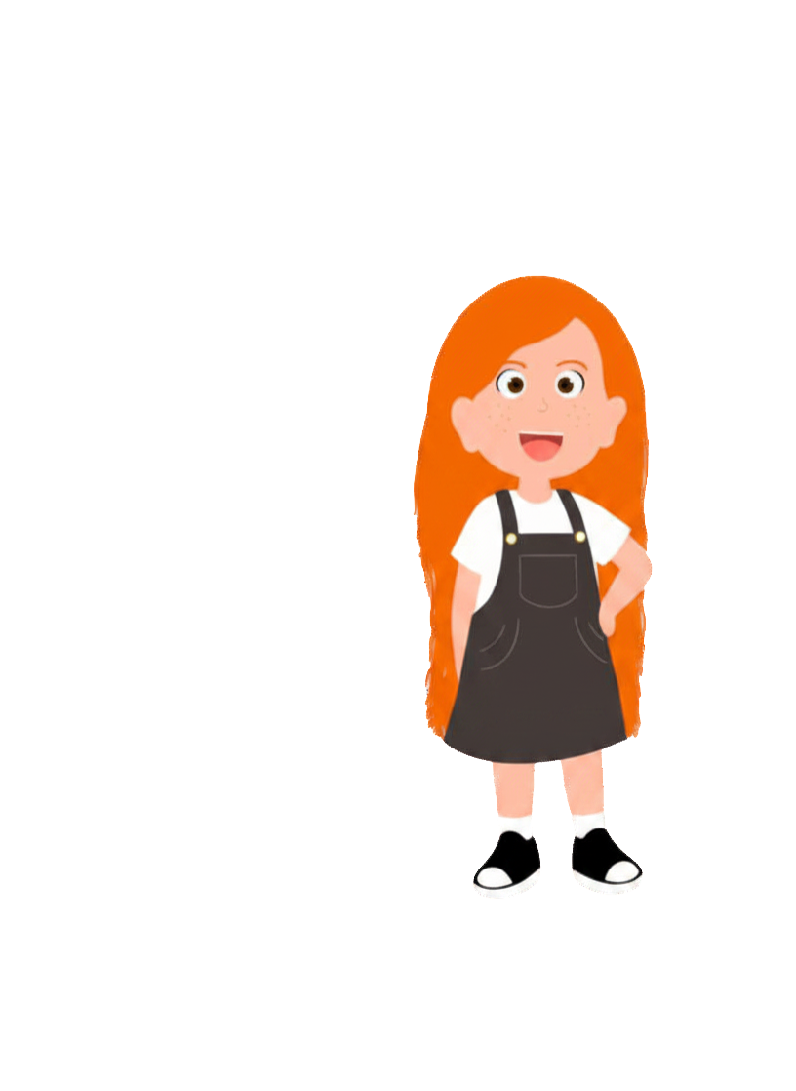
Our Special Rules
We listen carefully.
We take turns.
We are kind and don’t make fun of others.
We only use people’s names when being kind.
We can pass if we don’t have anything to share.
We can ask questions if we don’t understand.
We can talk to someone if we are worried.
Year 3/P4 (ages 7-8) | Who looks after our town?
Notes:
Safeguarding
This lesson is about the local council, council tax and caring for the environment. Some families may be struggling to pay bills, including council tax, and some children may live in temporary accommodation or areas with fewer facilities. Use the characters to keep discussion one step removed, and never ask children whether their family pays council tax or can afford new things. Present second-hand and borrowed items positively: they are sensible, sustainable choices, not a sign of being poor.
Avoid party-political comment. Councillors may belong to different political parties; keep the focus on what councils do and how people can have their say.
Remind children of the ground rules and that they won't have to share anything private if they don't want to. Provide a strategy such as a 'Tell Me Anything Box' where children can post any private concerns or comments that they want you to see. If a child discloses a worry, follow your school's safeguarding procedures and inform your Designated Safeguarding Lead if necessary.
At the start of the lesson, reinforce the ground rules for everyone.

Slide 2
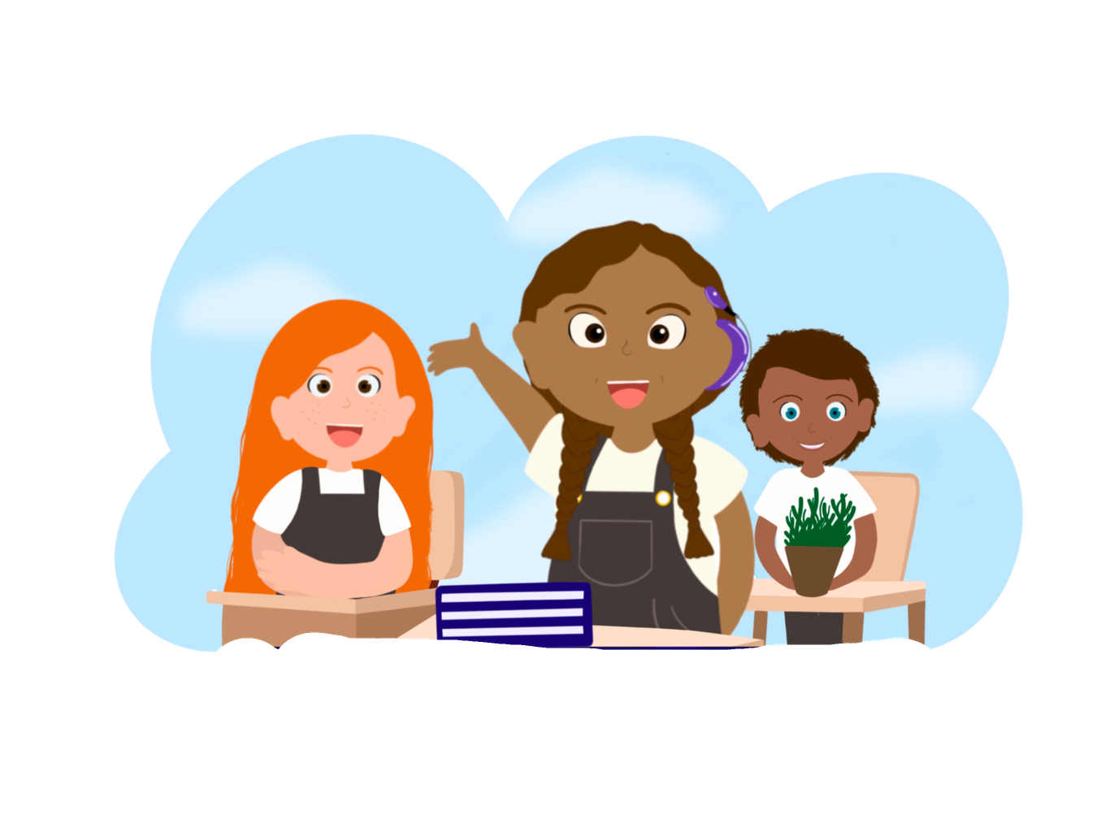
My learning challenges
  What does our local council do?
  How is the council paid for?
  How can our choices help the planet?
Year 3/P4 (ages 7-8) | Who looks after our town?
Notes:
Share the learning challenges with the class. You will return to them at the end of the lesson (Slide 11).

Slide 3


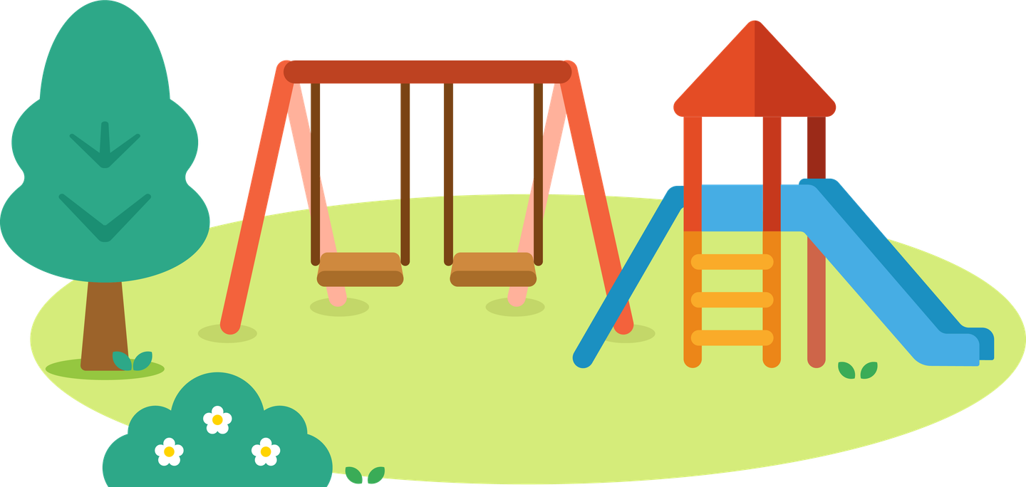
Activity 1
Who pays for these?
Notes:
Activity 1 (10 minutes): Who pays for these?
NOTE: There is a word bank at the end of your slide deck.
Starter: Show photos (or draw quick sketches) of a wheelie bin, a park, a library and a streetlight. Ask: Who looks after these? Who pays for them? Take ideas without correcting yet.
Recap from Year 2 and earlier in Year 3: we know that families budget their money and choose what to spend it on. Today we find out that a whole town or city also has to make choices about money.

Slide 4
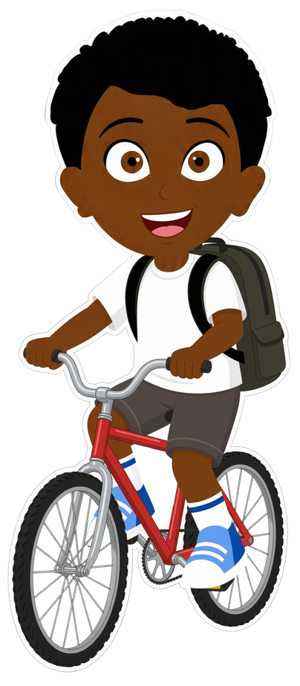
Activity 1
A council is a group of people who look after our local area.
Councillors are chosen by local people in an election.
Year 3/P4 (ages 7-8) | Who looks after our town?
Notes:
Share the definition on this slide. Explain that a council looks after lots of things in our local area. The people who make decisions for the council are called councillors. Grown-ups who live in the area vote for them in a local election, usually every four years. Councillors are ordinary people from the area who want to help it.
Introduce Bo. He loves riding his bike to the park at the weekend. Ask: Which things on Bo's journey might the council look after? (the roads, the pavement, streetlights, road crossings, the park, the bins and benches in the park)
Note: in Scotland and Northern Ireland, councils work in a similar way. Some areas have more than one council (for example, a county council and a district council) which share the jobs.

Slide 5
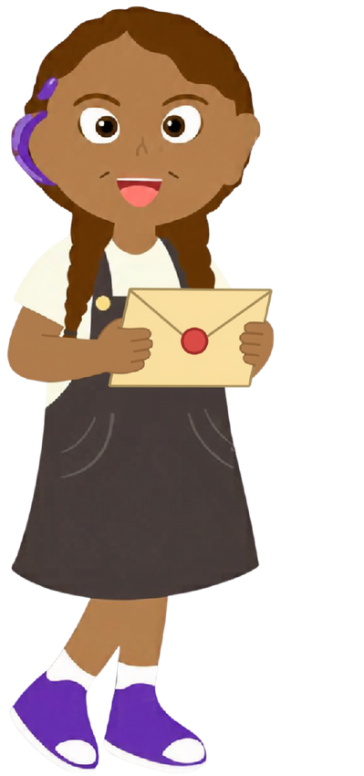
Paying for our town
Activity 1
Grown-ups pay council tax.
It helps to pay for:
  emptying bins and recycling
  parks and playgrounds
  libraries
  streetlights and pavements
Year 3/P4 (ages 7-8) | Who looks after our town?
Notes:
Introduce Taz. Her dad works in a bank, so she knows a bit about money. She has noticed a letter at home that says 'Council Tax'.
Explain that most households pay council tax to the local council. The amount depends on the size and value of the home, and some people pay less or nothing, for example if they have a low income, live alone or are a student. Taxes are a way of sharing the cost of things that everybody uses.
Read the list of services together. Other services councils pay for include: schools (in many areas), care for older and disabled people, housing, road repairs, road crossings, leisure centres and swimming pools, and keeping streets clean.
Ask: Which of these services have you used this week? Which service do you think costs the most? (Care for older and disabled people and children's services usually cost councils the most.)
Ask: What would happen if nobody paid council tax? (Bins would not be emptied, parks would not be looked after, libraries might close.)
Note for Northern Ireland: households pay 'rates' rather than council tax, and some services (such as schools and roads) are run by other organisations. Use the term that fits your setting.

Slide 6
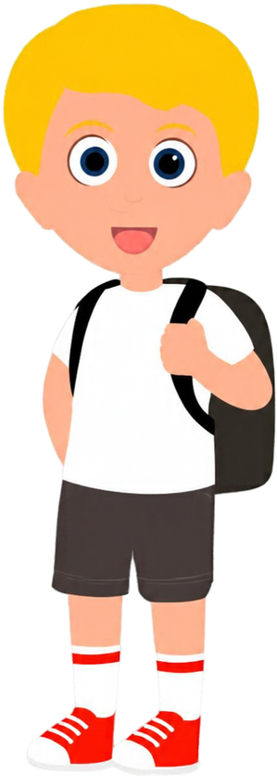
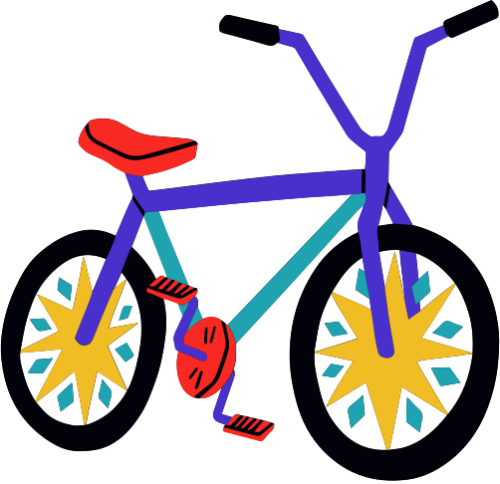
Flip's new bike
Activity 2
Flip has grown too big for his bike.
His family has three choices:
A: buy a new bike for £120
B: buy a second-hand bike for £40
C: borrow his cousin's old bike
Year 3/P4 (ages 7-8) | Who looks after our town?
Notes:
Activity 2 (20 minutes): Flip's new bike
Explain that it isn't only councils that make choices which affect our area and our planet. Families make choices every day too.
Introduce Flip. He is sporty and loves riding his bike, but he has grown too big for it. His dad works for the fire service and his mum works at a supermarket.
Read the three choices together. Check understanding of 'second-hand' (something that has been owned and used by someone else before, and is sold or given on). Ask: Where can you find second-hand things? (charity shops, car boot sales, online selling sites, school sales, friends and family)
Ask: What is the difference in price between the new bike and the second-hand bike? (£80) How much does borrowing cost? (nothing, though it is polite to look after it and give it back, or pass it on)
Introduce the word 'sustainable': a choice that does not use up more of the planet's resources than we need. Making a new bike uses metal, rubber, plastic and energy, and the bike has to be transported to the shop. Reusing a bike keeps it out of landfill.
Then move to the next slide, where groups weigh up the choices.

Slide 7

Activity 2
Help Flip's family choose.
1. What is good about each choice?
2. What could be a problem with each choice?
3. Which choice is kindest to the planet?
Which would you choose? Why?
Year 3/P4 (ages 7-8) | Who looks after our town?
Notes:
In small groups, children use the 'Flip's bike choices' sheet at the end of the teacher notes PDF. For each choice, they record what is good about it and what could be a problem, thinking about cost, value and the planet.
Possible answers:
A: New bike (£120). Good: it is the right size, has no wear and tear, may come with a guarantee and could be passed on later. Problems: it costs the most, and making a new bike uses metal, plastic, rubber and energy.
B: Second-hand bike (£40). Good: it saves £80, which could be spent on a helmet and lights or saved; it reuses something that already exists. Problems: it might need repairs, may not be the colour Flip wants, and you should check that the brakes and tyres are safe.
C: Borrow his cousin's bike (free). Good: it costs nothing and uses no new materials. Problems: it might not be quite the right size, and Flip must look after it and give it back when asked.
Draw out that there is no single right answer. A good choice balances cost, value (how much use you get for the money) and the effect on the planet. Make clear that second-hand and borrowed things are smart, sustainable choices that many families make.
Support: give children picture cards for each choice and a simple 'good / problem' sorting mat.
Challenge: if the family chose the second-hand bike, how could they use the £80 they saved? What would be a sensible choice?

Slide 8
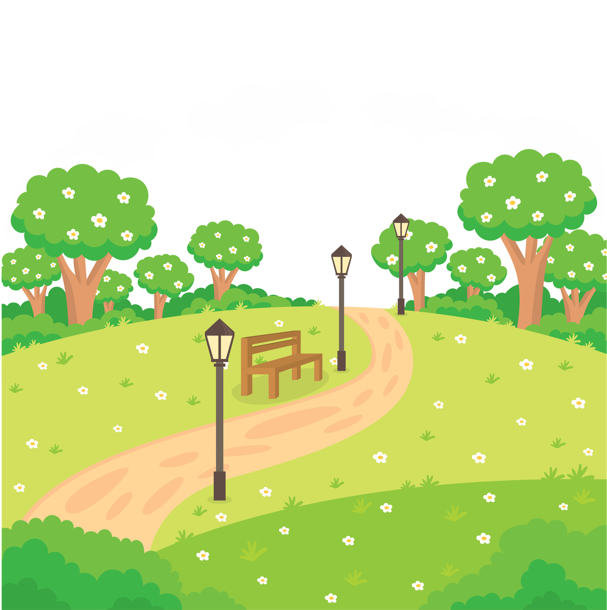
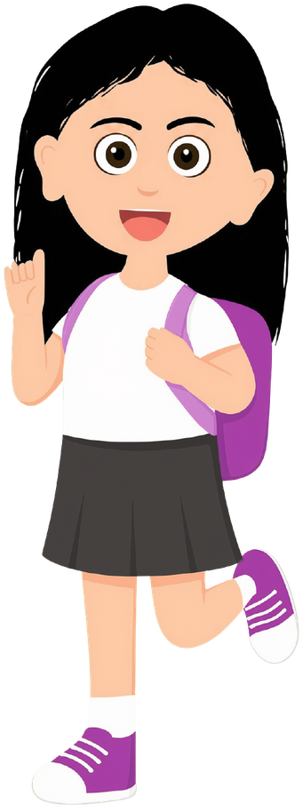





Speak up for your area
Activity 3
Maz has noticed litter in the park near her home, and there is nowhere to recycle.
She wants to write to her local councillor to suggest an improvement.
Year 3/P4 (ages 7-8) | Who looks after our town?
Notes:
Activity 3 (15 minutes): Speak up for your area
Introduce Maz. She is very kind, especially to animals, and she walks her family's dog in the local park. Read the slide together.
Explain that councillors are there to listen to the people who live in their area, including children. Anyone can write to their councillor or email them, and their contact details are on the council's website. Many areas also have a youth council or children's council.
Ask: What could Maz suggest? (more bins, recycling bins, a litter-pick day, signs asking people to take litter home, planting trees or flowers)
Model a short letter on the board, then children write their own using the 'Letter to a councillor' frame at the end of the teacher notes PDF. They choose one improvement to their area's environment and give a reason. The frame includes:
Dear Councillor,
My name is ... and I am in Year 3.
I would like to suggest ...
This would help our area because ...
Thank you for reading my letter.
Children can write about their own area or about the area where Maz lives. Keep letters positive and polite: we suggest improvements rather than complain.
Optional: with permission, send a selection of letters to your local councillor or invite them to visit the class.

Slide 9

Spending choices
Activity 4
Which statement do you agree with? Why?
The council should plant more trees in parks.
The council should fix more holes in roads.
Year 3/P4 (ages 7-8) | Who looks after our town?
Notes:
Activity 4 (10 minutes): Spending choices
Explain that the council only has a certain amount of money, just like a family budget. It cannot pay for everything, so councillors have to decide what matters most.
Read the two statements. Children stand on one side of the room or the other (or use thumbs up/down) and a few explain their choice.
Draw out that both choices are good ones. Trees clean the air, give shade, provide homes for wildlife and make parks nicer places to be. Fixing roads keeps cyclists, drivers and pedestrians safe, and helps buses and emergency vehicles get around. Councillors listen to local people and then vote on how to spend the money.
Ask: If the council chose trees this year, what could happen to the roads? How could the council find more money? (charge for some services, ask for more council tax, get money from the government, save money elsewhere)
Keep the discussion about choices and priorities rather than political parties.
Then use the challenge cards on Slides 9 and 10. Children can work in pairs and record their answers on mini whiteboards.

Slide 10

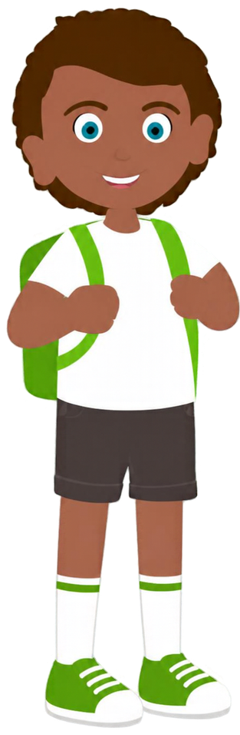
Activity 4
Ty's streetlight is broken. Who pays to fix it?
Year 3/P4 (ages 7-8) | Who looks after our town?
Notes:
Challenge card 1
Possible answers: The council looks after streetlights, so the council pays to fix it, using money from council tax (in some areas it may be a different organisation that looks after roads and lighting). Someone can report it on the council's website or by phone.
Ask: Why do streetlights matter? (they help people see where they are going and feel safe at night, and they help drivers see people crossing)
Link: Ty's dad is an electrician. Ask: What kind of worker might the council send to fix it? (an electrician or a lighting engineer) The council pays people and companies to do jobs like this, so council tax also helps to create jobs in the area.

Slide 11


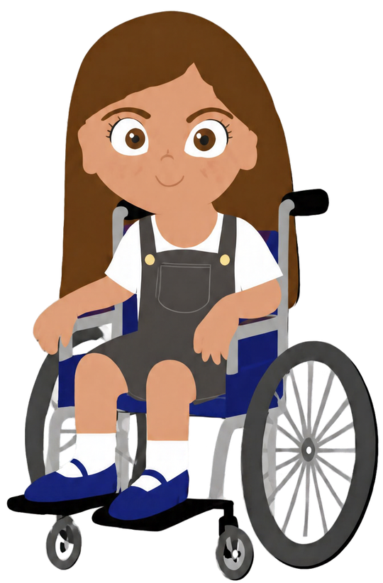
Activity 4
Fee's library built a ramp. Why should services be for everyone?
Year 3/P4 (ages 7-8) | Who looks after our town?
Notes:
Challenge card 2
Fee loves reading about art and uses her local library. She sometimes uses a wheelchair as she was born with a rare problem with her bones.
Possible answers: Everyone in the area helps to pay for council services, so everyone should be able to use them. A ramp means Fee, and people with pushchairs or walking frames, can get into the library on their own. It is fair, and the law says that public services must make reasonable changes so disabled people can use them.
Ask: What other changes help everyone to use places in our town? (lifts, wide doors, dropped kerbs, accessible toilets, quiet hours, large-print and audio books)
Extension: If you were a councillor, what one change would you make so that your area works well for everyone?

Slide 12
Let's revisit our learning challenges
  What does our local council do?
  How is the council paid for?
  How can our choices help the planet?
Year 3/P4 (ages 7-8) | Who looks after our town?
Notes:
Return to the learning challenges.
Can children respond accurately? Ask each child to tell a partner one service the council provides, and one sustainable choice a family can make (such as buying second-hand, borrowing, repairing or recycling). Listen in to a sample of pairs for assessment.
You could display the children's letters to a councillor on a 'Caring for our area' wall.
Looking ahead: in Year 4, children will find out how the whole country pays for services such as hospitals and schools through taxes.

Slide 13
Our town word bank
council
tax
park
recycle
planet
councillor
pay
library
reuse
nature
vote
services
bins
repair
litter
elect
budget
lights
borrow
trees
local
choice
roads
used
improve
area
fair
letter
waste
community
Year 3/P4 (ages 7-8) | Who looks after our town?
Notes:
Word bank for children who need support with discussion or written responses. A printable version is at the end of the teacher notes PDF.

