Slide 1
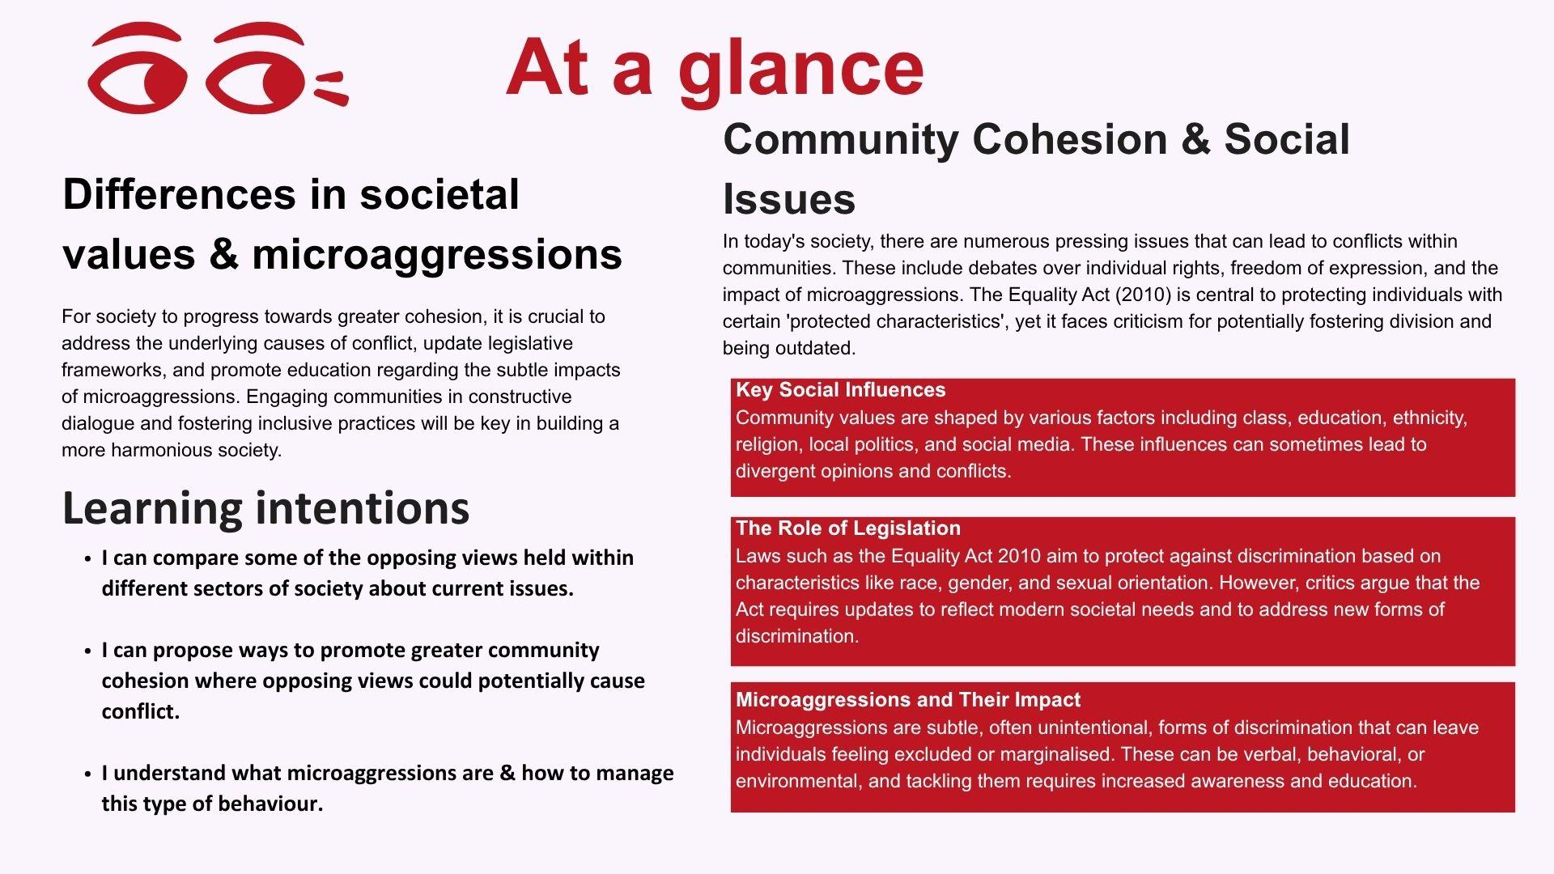

Slide 2
Rules of Engagement
    I have the right to share my opinion and be listened to
    I have the right to pass
    I have the right to be respected and valued
    I have the right to keep what I discuss confidential *
    I have the right to not feel judged
    I have the right to not answer personal questions
*unless what I say is causing concern and needs to be shared
Notes:
Safeguarding
This pack looks at some current issues that can be emotive in society and can cause conflict of opinions. It's important to ensure the class adheres to the ground rules which should be shared at the beginning of the lesson and referred to as required. This is so discussion remains respectful and distanced. If you have any concerns about individual students please follow the safeguarding protocols in your setting. You may wish to advise the class you will be taking on a 'devil's advocate' role and you will be chairing debate which may challenge their personal values but this does not reflect your opinions.
1

Slide 3


Take 10 Activity 1
What current issues cause a conflict of opinions in society (communities)?
Notes:
Take 10 Activity Choice 1: Controversial current issues
Show PowerPoint Slide 2 and with a partner ask the class to list current issues they're aware of where there are opposing opinions in society. Take some feedback and make a class list. Ask the class when disagreements erupt between individuals who have opposing values in relation to topics on the list, where do these arguments play out? (E.g., social media, in the public arena).
2

Slide 4
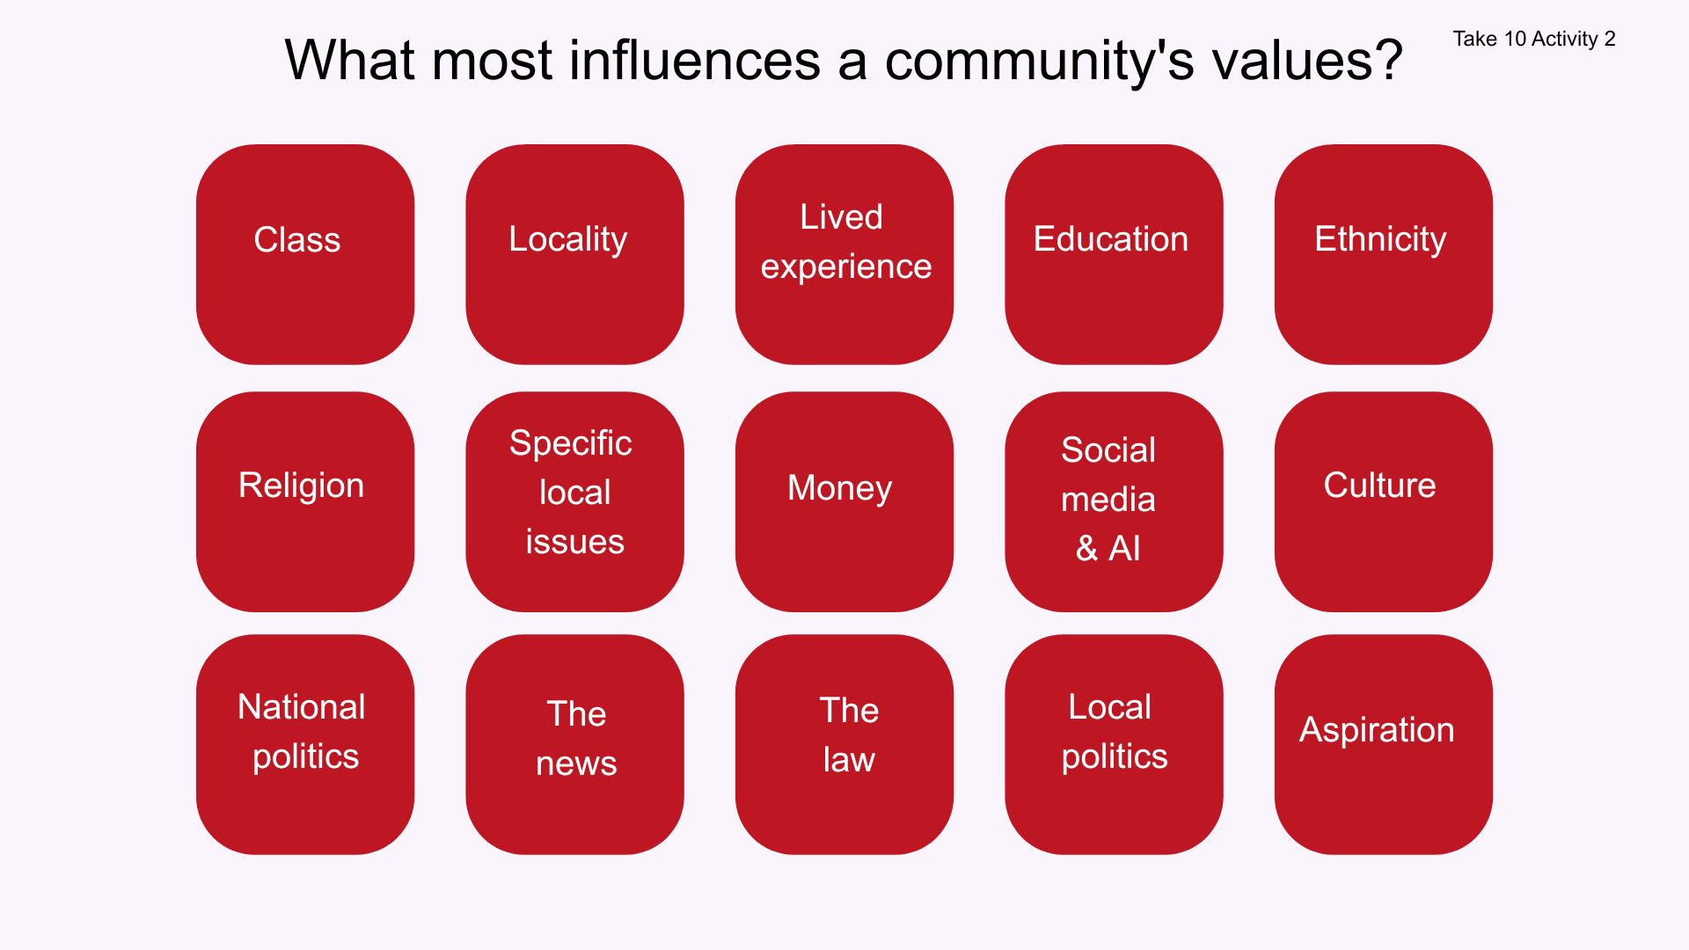
What most influences a community's values?
Take 10 Activity 2
Lived
experience
Class
Locality
Education
Ethnicity
Specific
local issues
Social media
& AI
Religion
Money
Culture
National
politics
The news
The law
Local
politics
Aspiration
Notes:
Take 10 Activity Choice 2: What influences societal values?
Ask students to look at the items on PowerPoint Slide 3 and in small groups choose the top 5 they feel have the most influence on a community's values. Take feedback from all the groups and make a list of everything that has been selected. Was there much difference between groups? Were there popular choices? What didn't make the list? If time allows you can then go on to rank the class list from most to least influential and discuss this in more detail.
3

Slide 5

The Equality Act (2010)
Take 10 Activity 3
This law aims to protect people with the following 'protected characteristics' from harassment, abuse, discrimination and prejudice:
Religion or belief
Race / culture
Disability
Sexual orientation
Marriage/ civil partnership
Pregnancy and maternity
Age
Gender reassignment
Sex
Notes:
Take 10 Activity Choice 3: Values and the Equality Act
Remind students about the Equality Act (2010) using PowerPoint Slide 4. Move on to PowerPoint Slide 5 which outlines some of the main criticisms of the Equality Act. Allow students to discuss this. Do they feel the law needs a re-vamp? How can conflicts be resolved where there are 'equal rights' on both sides of an argument?
4

Slide 6
The Equality Act (2010)
Take 10 Activity 3
Critics of this legislation claim the following:
    It needs updating
    New 'protected characteristics' should be included
    The modern interpretation has gone beyond it's original intent
    That it has contributed to 'woke culture' and 'cancel culture'
    That it sets up direct conflict between different sectors of the community, for example:
      Women's rights vs trans rights e.g., women only spaces
      Religious belief vs sexual orientation
      Men's rights vs women's rights

Slide 7

Take 20 Activity 1
Community cohesion refers to the aspect of togetherness and bonding exhibited by members of a community, the "glue" that holds a community together.
Notes:
Take 20 Activity Choice 1: Community cohesion
Begin this task by sharing the definition of community cohesion from PowerPoint Slide 6 and briefly discuss. Do the students feel we have community cohesion 'sorted' locally, nationally and worldwide? Show the quadrant on PowerPoint Slide 7 and ask students to work in groups and complete their own version. Some things they discuss may appear in more than one quadrant. Take feedback and discuss what improvements could be made within a community to improve cohesion and reduce conflict, especially where there are deeply held beliefs on opposing sides?
6

Slide 8
What would you change to improve community cohesion?
Take 20 Activity 1
Laws
Social media
Local communities
Education

Slide 9

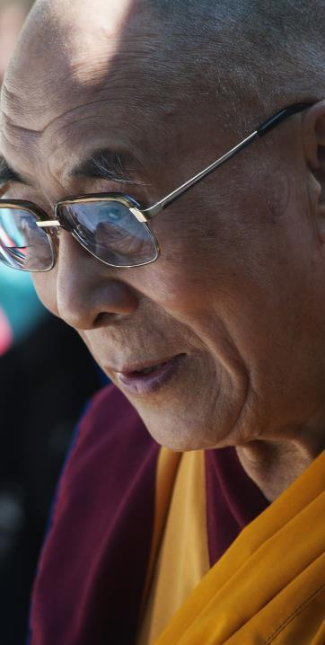
Take 20 Activity 2
"Most real change
is slow."
Dalai Lama
Notes:
Take 20 Activity Choice 2: Societal change- too fast or too slow?
Share the quote from the Dalai Lama from PowerPoint Slide 8 and discuss. The Dalai Lama is the spiritual leader of Tibet and a Buddhist Monk. Ask students if they can suggest examples that illustrate the quote. Take some feedback, then share the examples on PowerPoint Slides 9-12. Do the students consider these changes were fast or slow? Is there a delay between laws being passed and society accepting the change? Ask what might be the risk of societal change happening too quickly.
Share the discussion points on PowerPoint Slide 13. Use these to create a continuum activity where there is an imaginary line stretching across the classroom with either end representing agree/ disagree. Looking at each statement in turn from Slide 13, ask students to place themselves on the continuum as to how much they agree/disagree with each. Take feedback each time and discuss differences of opinion. Remember to reinforce the ground rules.
Conclude by asking students if they feel there are some aspects of society that require rapid change and how people can be encouraged rather than made to change? Do some changes require laws in order to be effective?
8

Slide 10
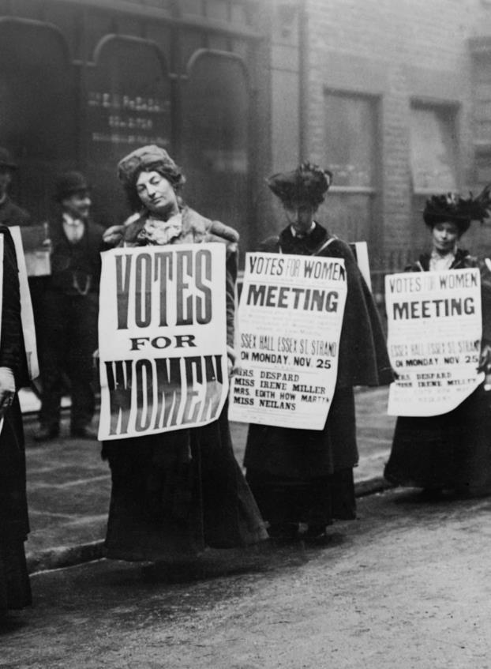

Take 20 Activity 2
The right to vote wasn't only about the suffragette movement who campaigned for women's votes in the early 20th Century. It took them 8 years to get a change in the law.
It's a little known fact that until 1918 only 58% of the adult male population were eligible to vote. At this point the voting age was 21 for men, and 30 for women.
The voting age was reduced to 18 for everyone in 1969.
Very recent changes means that 16 year olds can vote.

Slide 11

Take 20 Activity 2
The Criminal Law Amendment Act 1885, made any homosexual activity between males illegal. This meant gay men could be imprisoned.
In 1954, the Wolfenden committee recommended a change in the law to decriminalise consenting private sexual acts between gay men aged 21 and over.
It took 10 years for the law to be passed, in 1967. The law was not changed in Scotland until 1980 and Northern Ireland until 1982.
The age of consent was lowered to 16 in 2001.

Slide 12
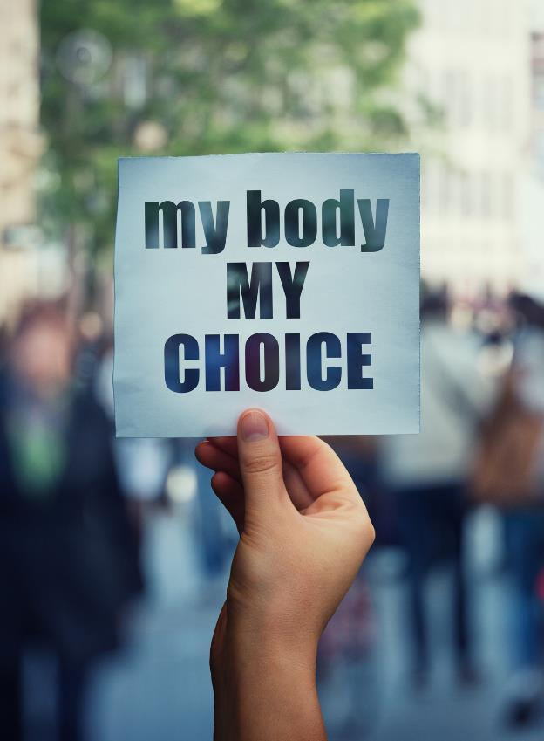
Take 20 Activity 2
Abortions were first criminalised in the early 19th Century in the UK. Women could be sent to prison or transported (to the colonies) for having a termination.
Abortion was not legalised in the UK until 1968 and this only applied to England, Wales and Scotland.
Abortion was legalised in Northern Ireland in 2020.
In the USA, the Supreme Court paved the way for individual states to prevent abortions.
The so-called Roe vs Wade decision was made in 2022.
There are other countries where abortion is illegal or difficult to arrange.
Notes:
Some European countries have legislation in place making abortion illegal or only available in very limited circumstances. These include Andorra, Malta, Lichtenstein, Poland

Slide 13
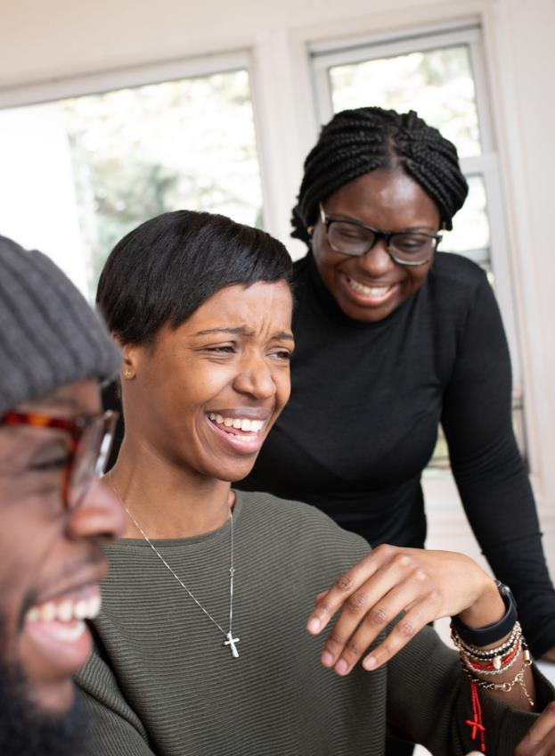
Take 20 Activity 2
The first UK law to protect the rights of black, Asian and other ethnic minorities was passed in 1965.
This law banned racial discrimination in public places.
It also made the promotion of hatred on the grounds of colour, race, or ethnic or national origins an offence.
However, these communities have been present in UK society for 100s of years.

Slide 14
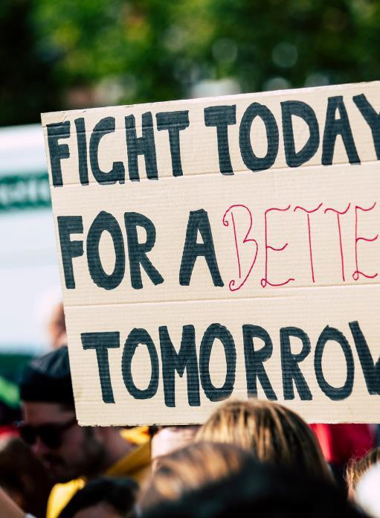

Take 20 Activity 3
Are there risks associated with 'fast-paced' change?
People find change difficult - agree or disagree?
It's better to bring people 'with you' rather than force them, even if this takes time - agree or disagree?
People are more likely to abide by the law if they feel they've had their say - agree or disagree?
Activism isn't always helpful - agree or disagree?
Most real change is slow - agree or disagree?
Notes:
Take 20 Activity Choice 3:
Microaggressions in society
This is an alternative activity that sits well within this library pack. It is designed to take between 20 and 30 minutes and can be found on PowerPoint slides 14-27. All the teacher notes are under the slides.
The activities are all distanced, however, there are opportunities for self-reflection and even more open personal discussion if you think this would work well in your group. You may wish to remind students of the ground rules.
Use slide 14 to introduce the first task. Give a few minutes for discussion and then take some feedback.
Definition:
a comment or action that subtly and often unconsciously or unintentionally expresses a prejudiced attitude toward a member of a marginalised group (such as a racial minority).
Protected characteristics under the Equality Act 2010 could be used as examples, but microaggression will not be exclusive to this group.
The term microaggression was coined by psychiatrist Dr Chester M. Pierce and further developed by psychologist Dr. Derald Wing Sue in the 1970's.
(both working in USA)

Slide 15
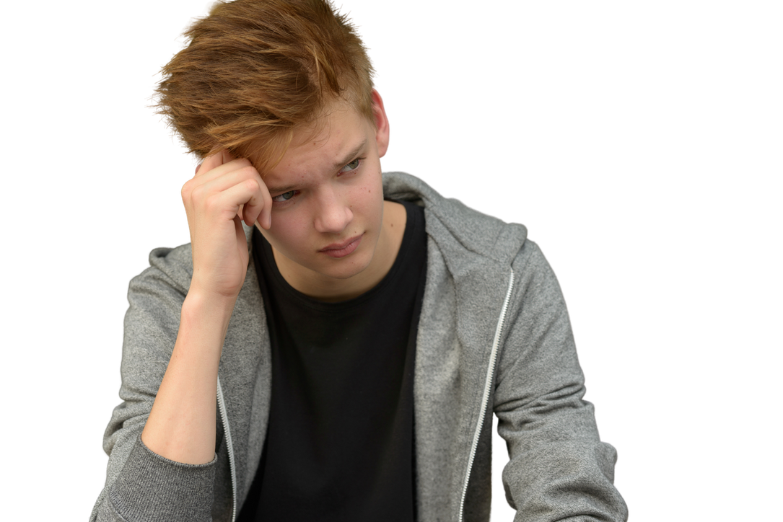
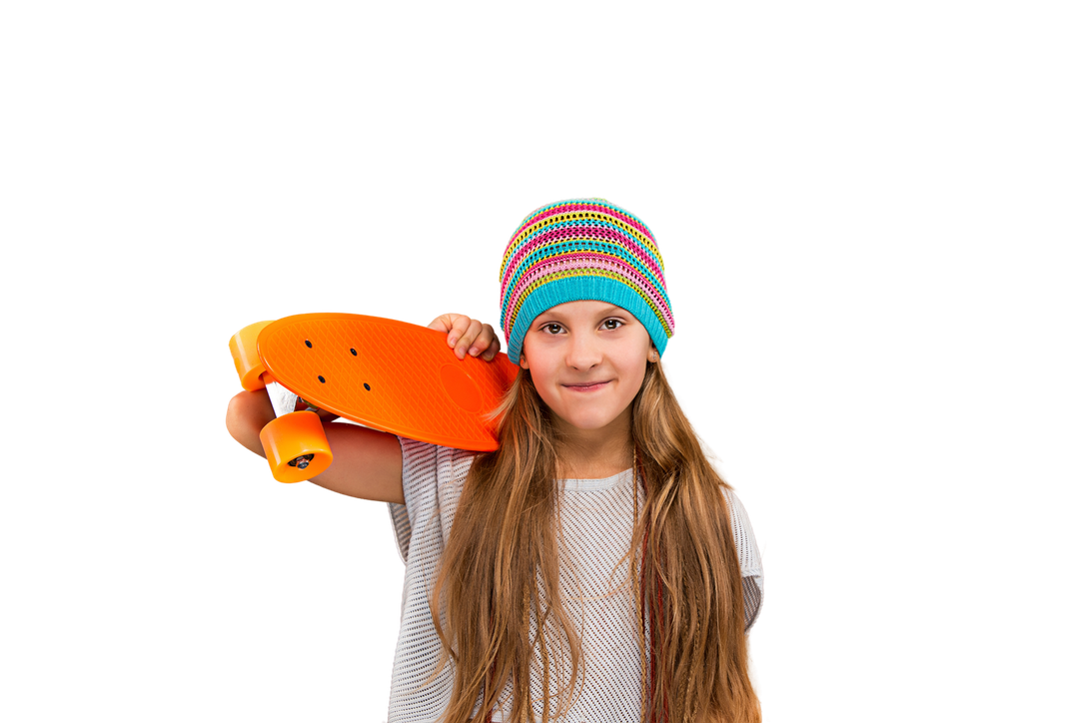


Take 20 Activity 3
What are microaggressions?
    Try to write a simple definition
    Can you think of some examples?
Notes:
Task students to work in pairs or small groups to suggest which individuals or groups may experience the types of comments on PowerPoint slides 15 and 16. Take some feedback as you discuss slides 17 and 18
with the group.
Ask your group to reflect on whether or not they have experienced microaggressions. They do not have to share experiences.

Slide 16
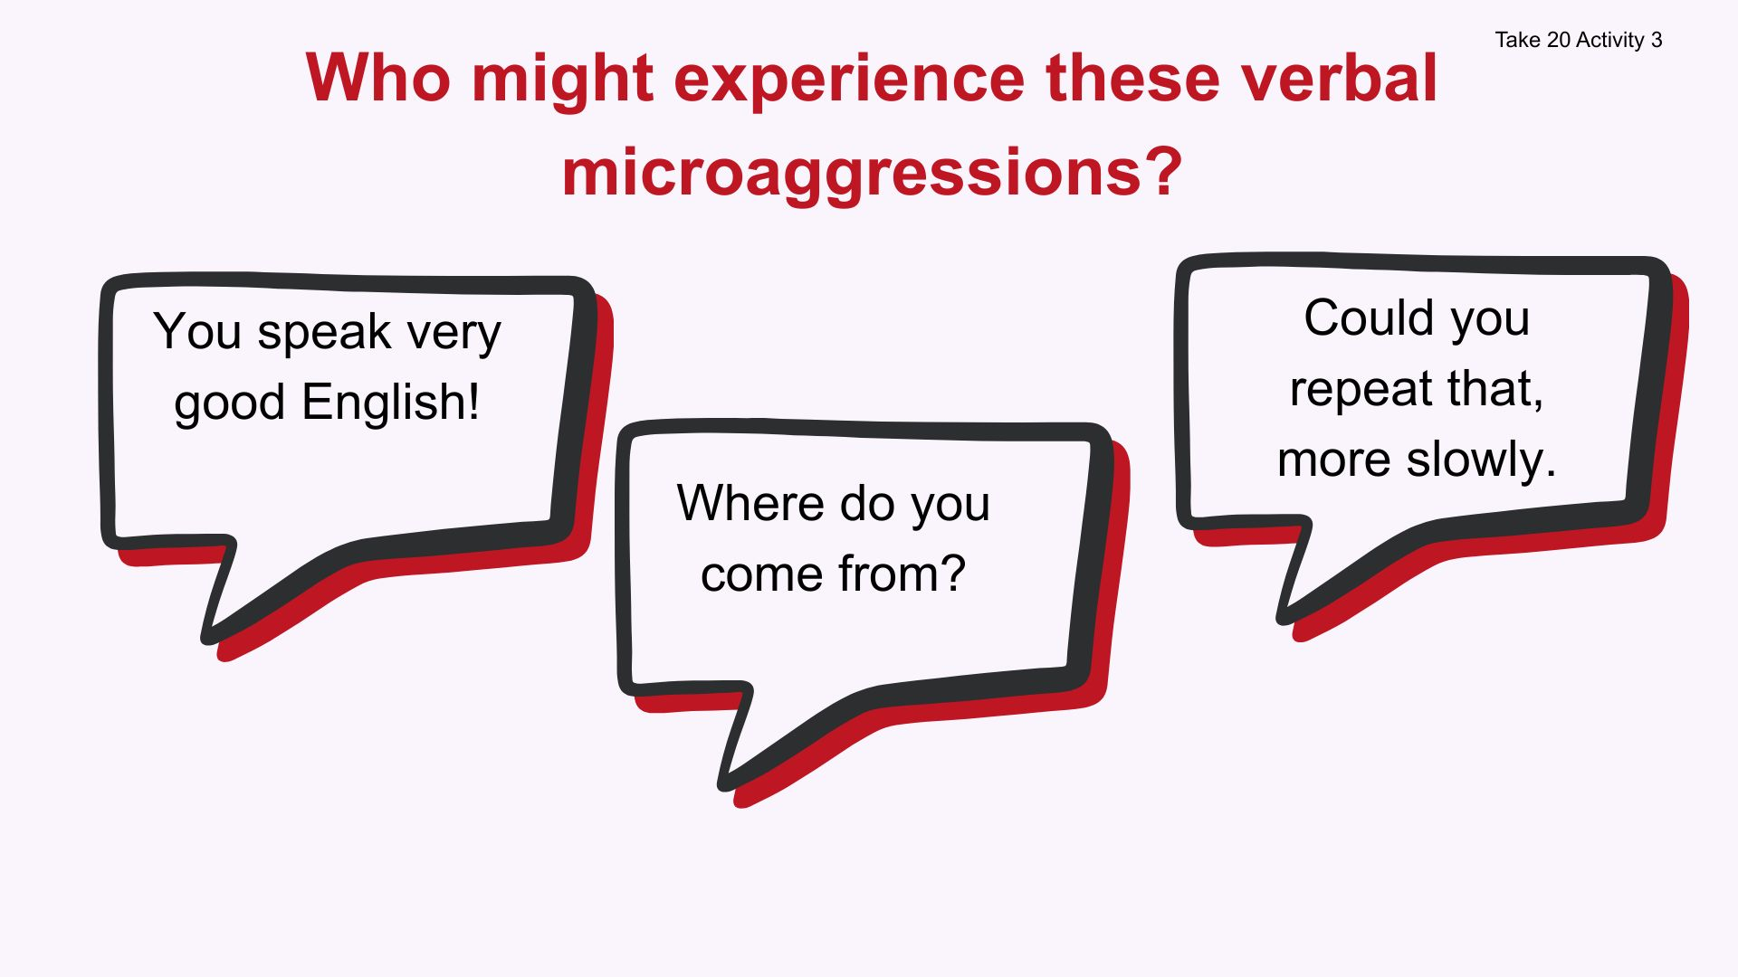

Slide 17


Slide 18
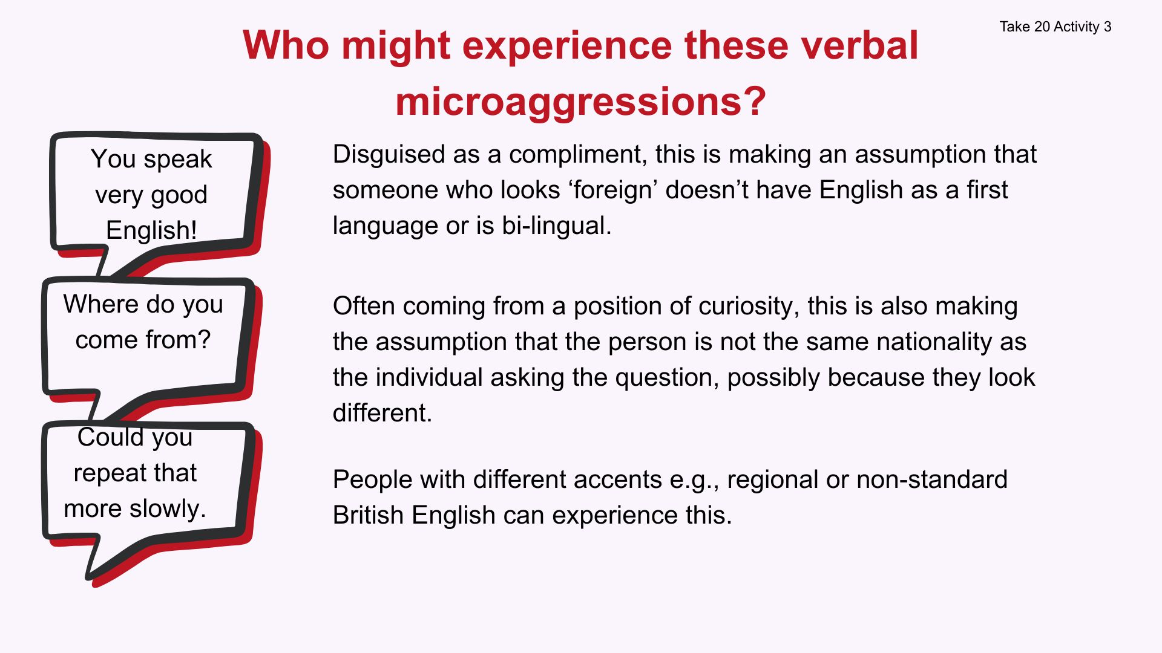

Slide 19
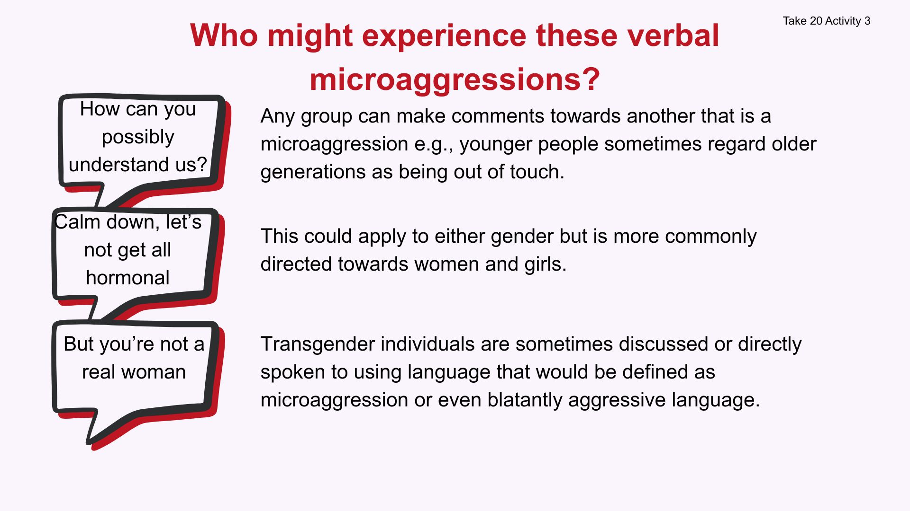

Slide 20

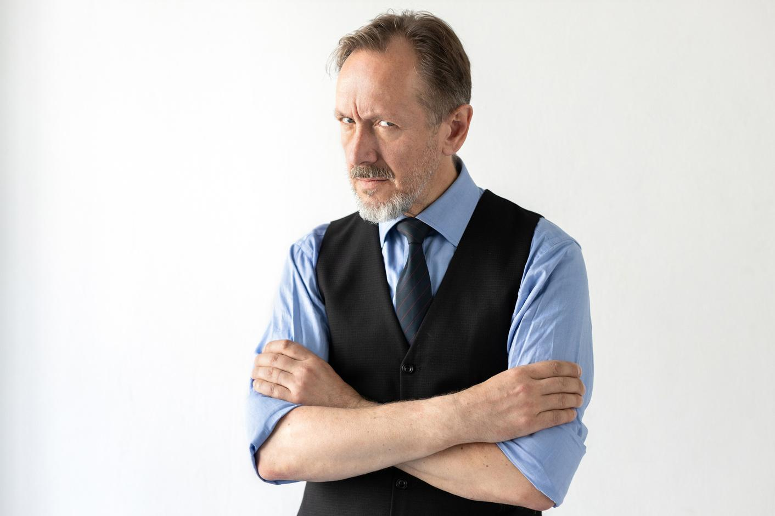
Non-verbal microaggressions
Take 20 Activity 3
Microaggressions are not always verbal. Non-verbal communication and actions can also fall into this type of behaviour.
    Discuss and suggest three examples on non-verbal micro-aggressions.
    Which individual or group is it aimed at?
Notes:
Show PowerPoint slide 19 and challenge the group to suggest non-verbal forms of microaggression.
If they need some help to get started share an example. E.g., A heterosexual couple are discussing buying a car and the salesperson only addresses the male.
When discussing a particular ethnic groups more focus and eye contact is made with an individual perceived to be from that group.
Take some feedback and then move onto PowerPoint slide 20.

Slide 21

Types of microaggressions
Take 20 Activity 3
    Verbal: A verbal microaggression is a comment or question that is hurtful or stigmatising to a marginalised group or person. For example, saying, “You’re so smart for a woman.”
    Behavioural: This involves behaving in a way that is discriminatory or otherwise hurtful to a marginalised person or group. E.g., when a waiter ignores a transgender person and instead serves a cisgender person, (someone whose biological sex matches their gender identity).
    Environmental: An environmental microaggression is when a subtle discrimination occurs within society, for example, when a town or city only has buildings named after white people.
Notes:
Sometimes the term 'structural' racism or bullying is used in the media. This refers to often quite subtle lack of equality that exits at an institutional or even societal level.

Slide 22
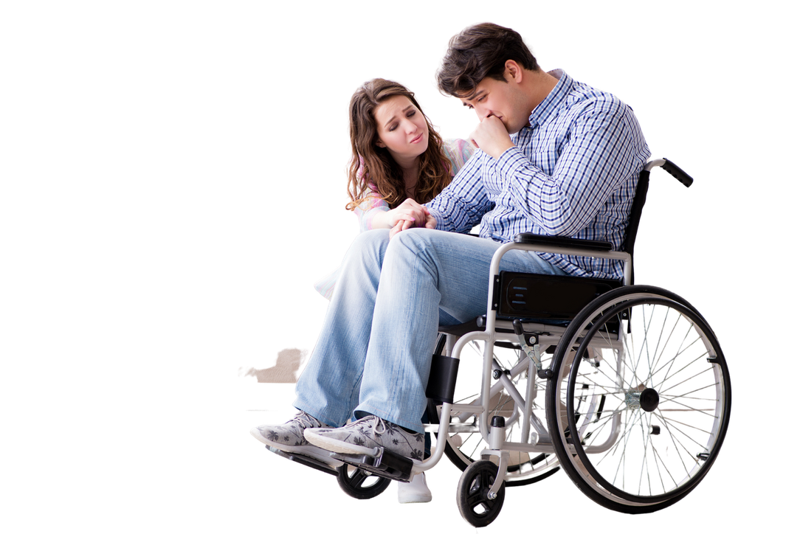
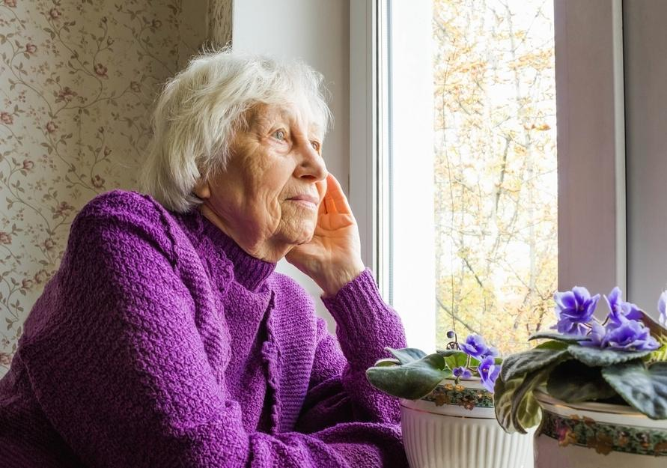
How do microaggressions make individuals or groups feel?
Take 20 Activity 3
Notes:
Show PowerPoint slide 21 and give the class some time to discuss and make suggestions before moving onto slide 22.

Slide 23
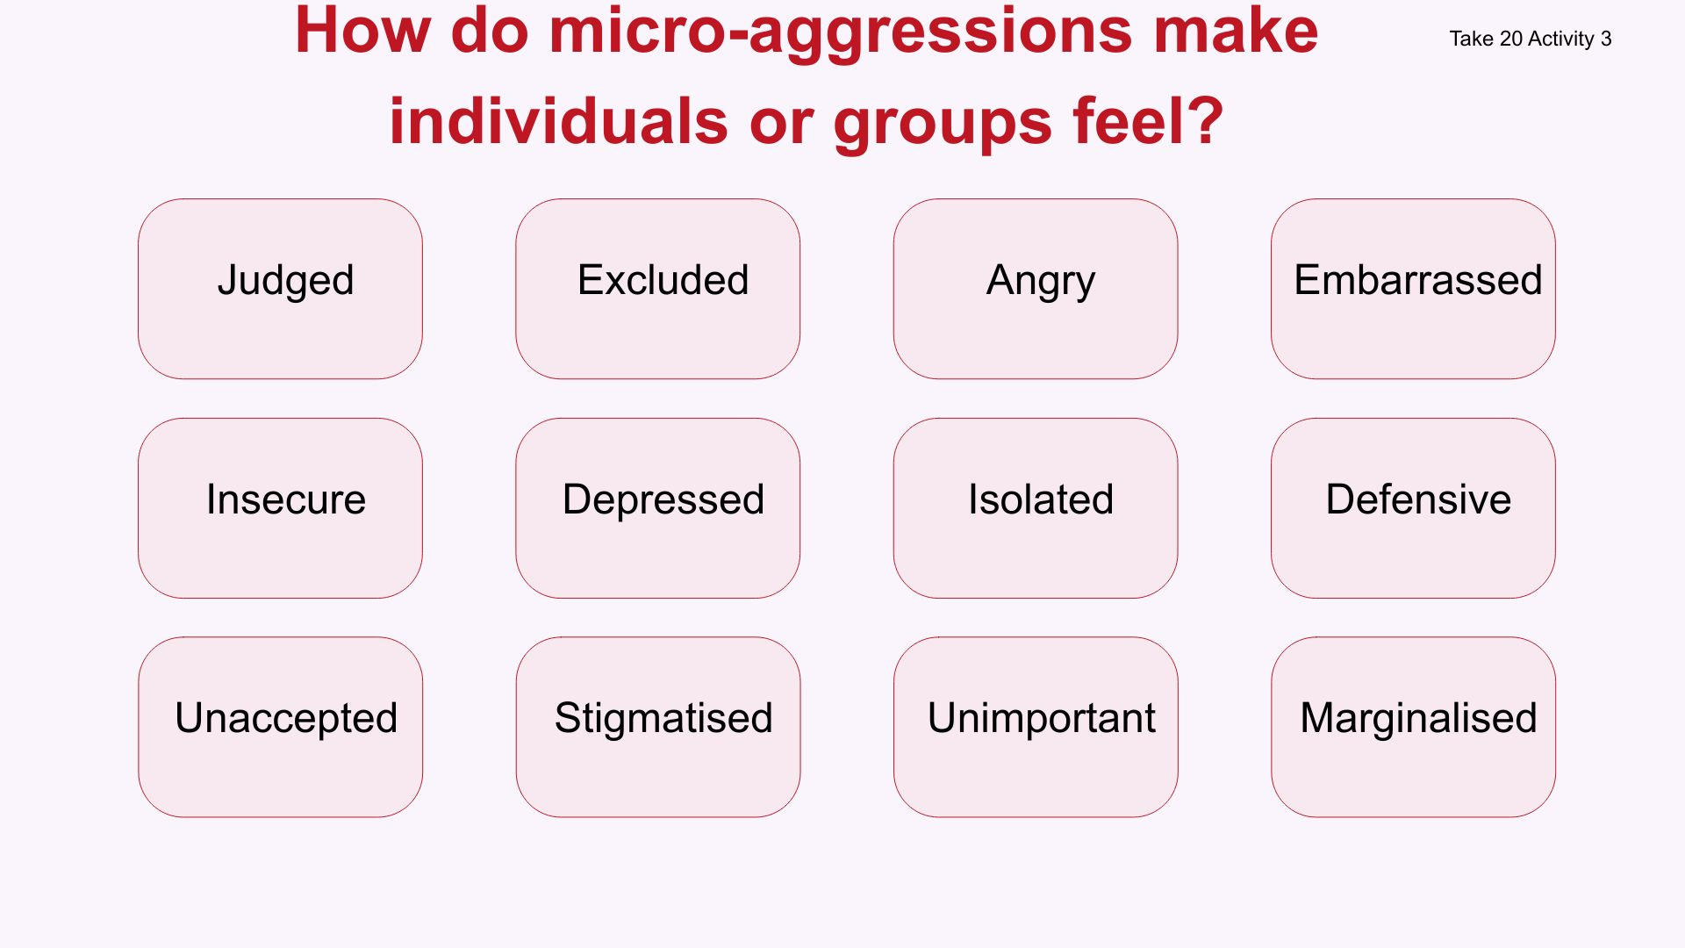
Notes:
Have they come up with similar suggestions? Anything to add? Anything they disagree with?

Slide 24

Microaggression - why do we do it?
Take 20 Activity 3
Notes:
Show slide 23 and give some time for suggestions or if the class feels confident to feedback immediately, take suggestions, then move onto slide 24.

Slide 25
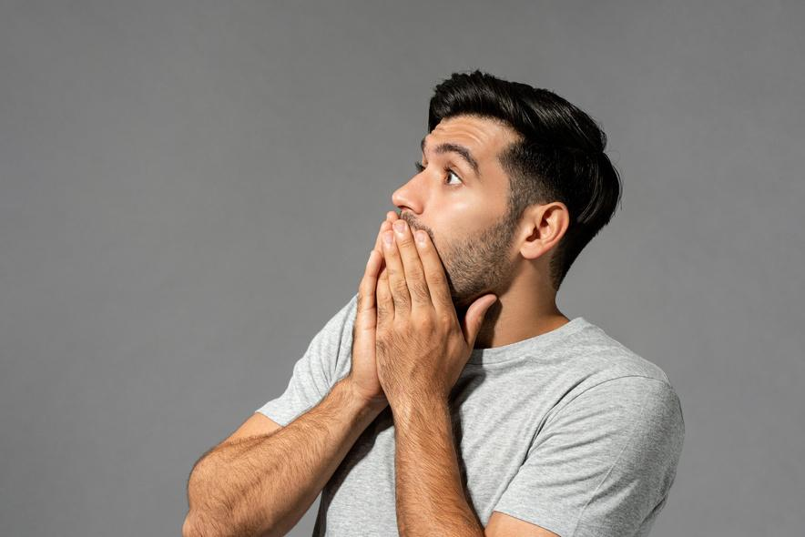
Microaggression - why do we do it?
Take 20 Activity 3
Prejudice
Unintentional
Normalised
behaviour
Lack of
awareness
Bias
Misplaced
humour

Slide 26
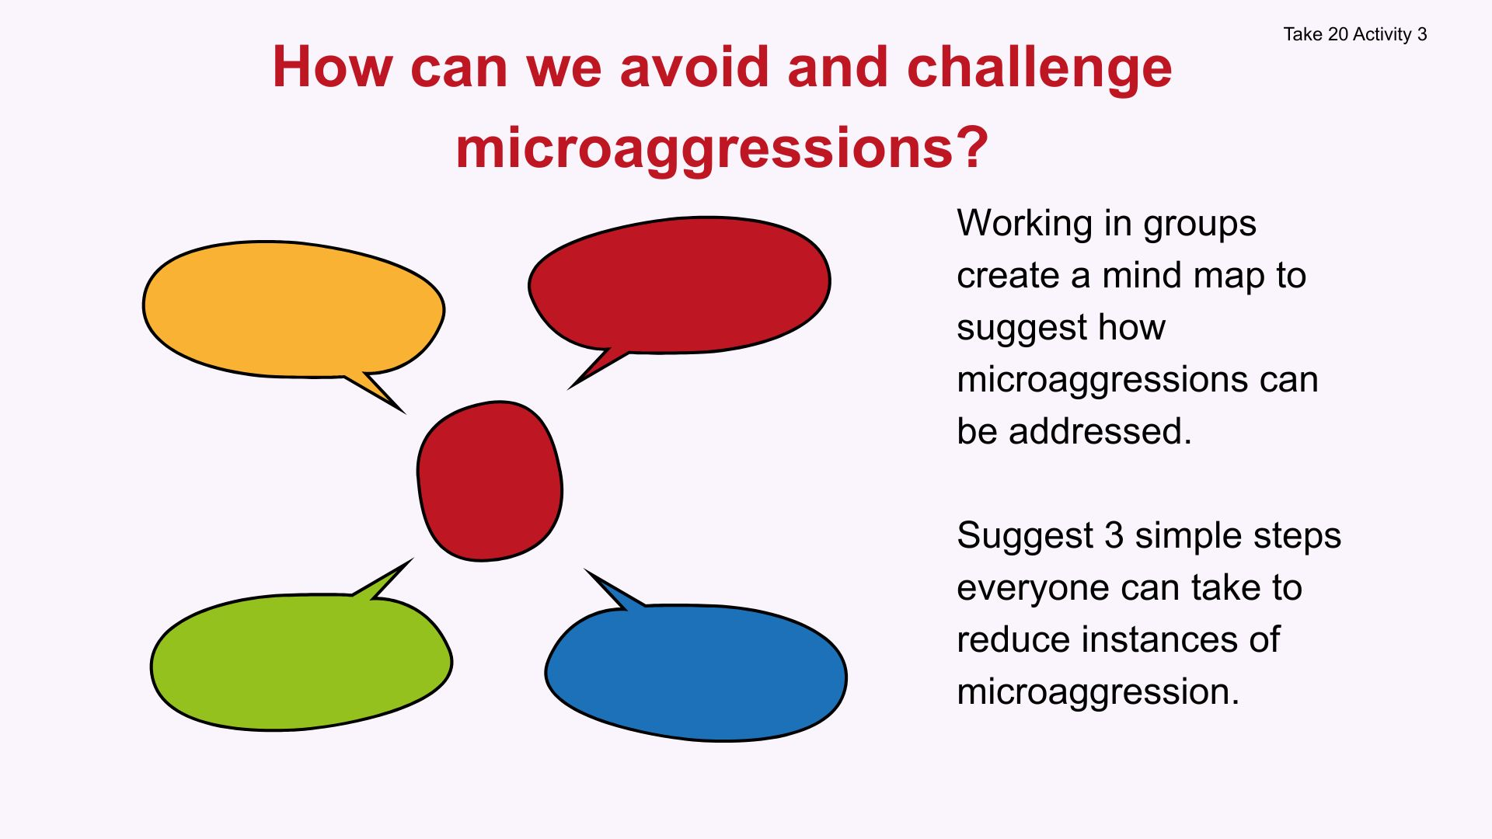
Notes:
This is the final task and focuses on thinking about the actions and practical solutions that can be implemented around microaggressions.
Give some time for the group to discuss, take feedback and then summarise with slides 26 and 27.

Slide 27

Reducing microaggressions
Take 20 Activity 3
    Listen to the person receiving the microaggression and empathise with their feelings.
    Try not to be defensive or dismiss the person’s feelings.
    Take responsibility for any underlying bias held toward certain groups.
    Take steps to become more informed and understanding.
    Commit to changing micro-aggressive behaviours.
    Be an ally not a bystander (or enabler)

Slide 28
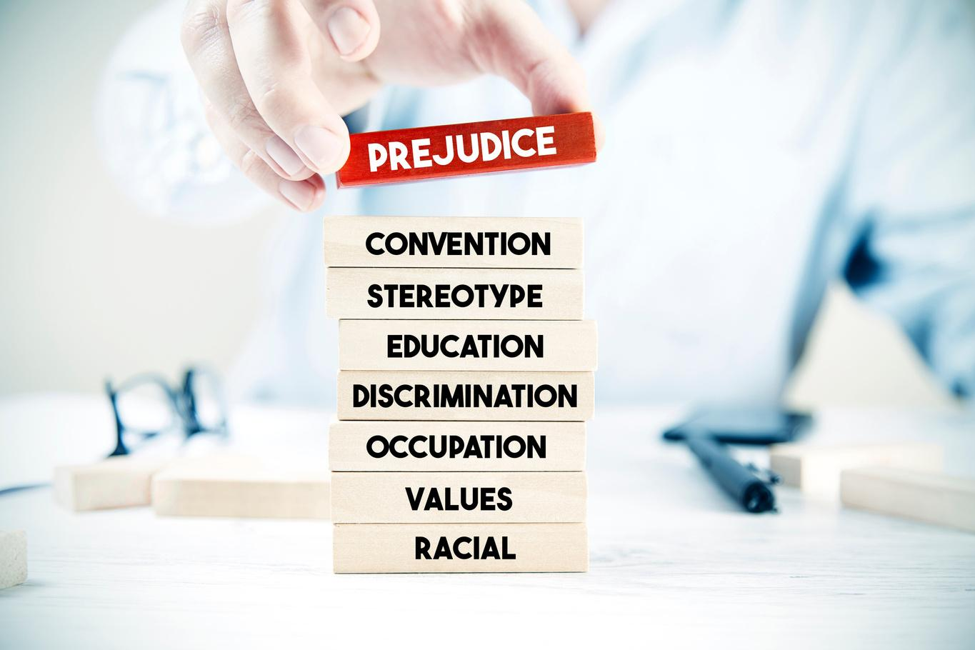
Challenging microaggressions
Take 20 Activity 3
    Respond to the microaggression if it feels safe to do so.
    Let the person know how the microaggression made you feel and why it is significant.
    Criticise the microaggression, not the person.
    Take care of yourself by seeking social support and practicing healthy self-care techniques.

Slide 29

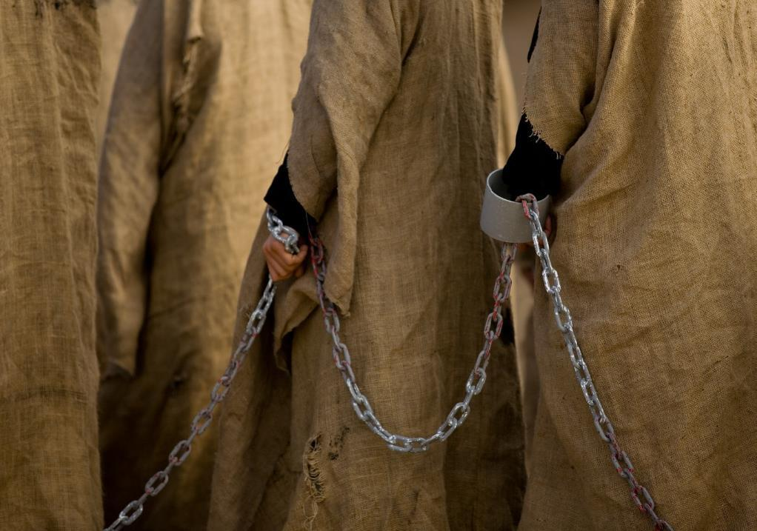
Take 30 Activity
Anything that honours or references slave traders should be removed from history.
Agree or disagree?
Notes:
Take 30 Activity Choice : Current issues- speed debates
This activity gives class an opportunity to consider some of the issues in society that can promote polarised views. Students should debate so it's important to reinforce the ground rules throughout the task. There are 20 statements to move through on PowerPoint Slides 14-33 so students can only spend a minute on each. They should discuss each statement in groups.
Show each statement in turn, note that some are deliberately controversial and have been included as they are 'live societal issues'. The purpose of this activity is not to cause offence, but instead raise students' awareness of current issues and the challenges in society associated with balancing individual and collective rights alongside free speech. This should be explained to the students in advance. The statements are examples of opinions that some people in society might hold and are not representative of your school values or the values of Chameleon PDE.
At the end of the task ask students how they felt debating these issues? Was it easy in the time-limit? Were there differences of opinion? Do these topics have the potential to cause offence? You are not asking students to share their group discussions but reflect on how they found the activity.
Explain the time-limit was imposed to 'simulate' social media. Platforms (TikTk, X, Instagram) have become places where personal values are aired, conflict is played out, and offence can be caused (sometimes this is illegal activity such as hate speech). Ask students how easy (or not) it would be to post something regretful when having an online disagreement with someone on social media about a controversial topic. Is the immediacy associated with social media a problem? Can they suggest actions someone could take to avoid getting into unnecessary online conflicts? When do they feel it's OK to say what you think online, and when is it not OK? Take some feedback to conclude the task.
28

Slide 30
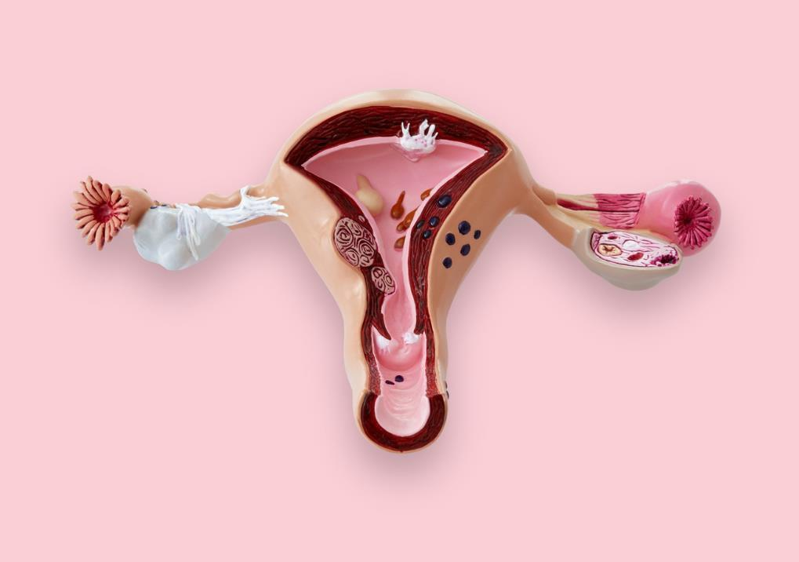
Someone can only be a woman if they were born with a womb and ovaries.
Agree or disagree?

Slide 31
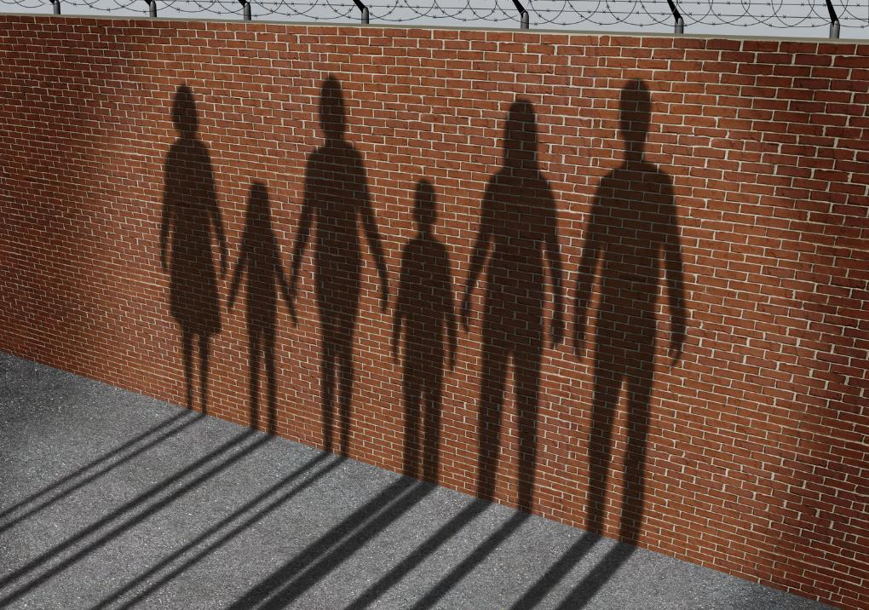
It's OK for illegal immigrants to be immediately deported to their country or origin or another country.
Agree or disagree?

Slide 32
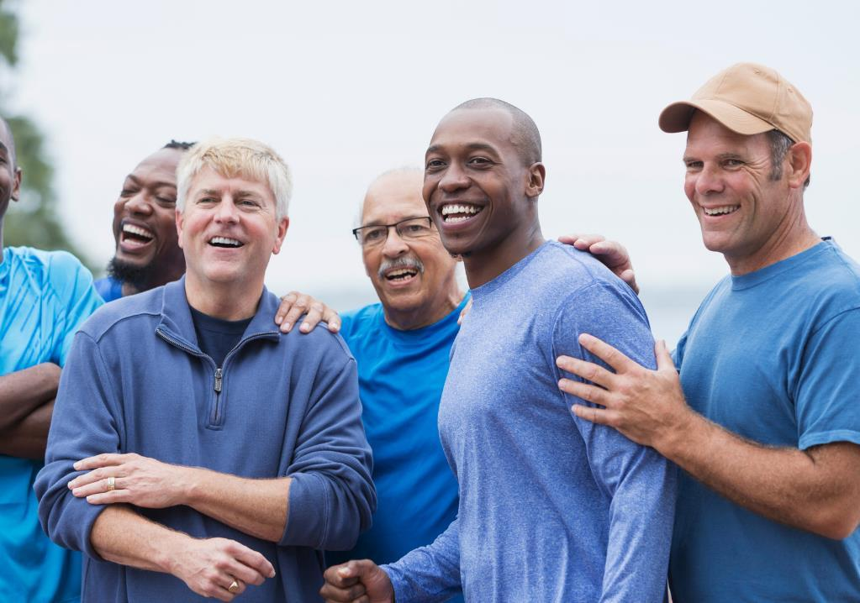
Rape culture is propagated by men.
Agree or disagree?

Slide 33
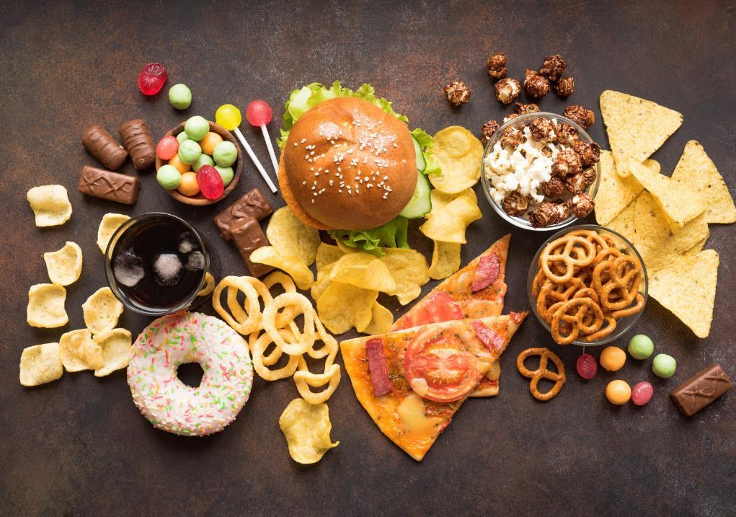
Unhealthy food and alcohol is too cheap which is why we have a public health crisis.
Agree or disagree?

Slide 34
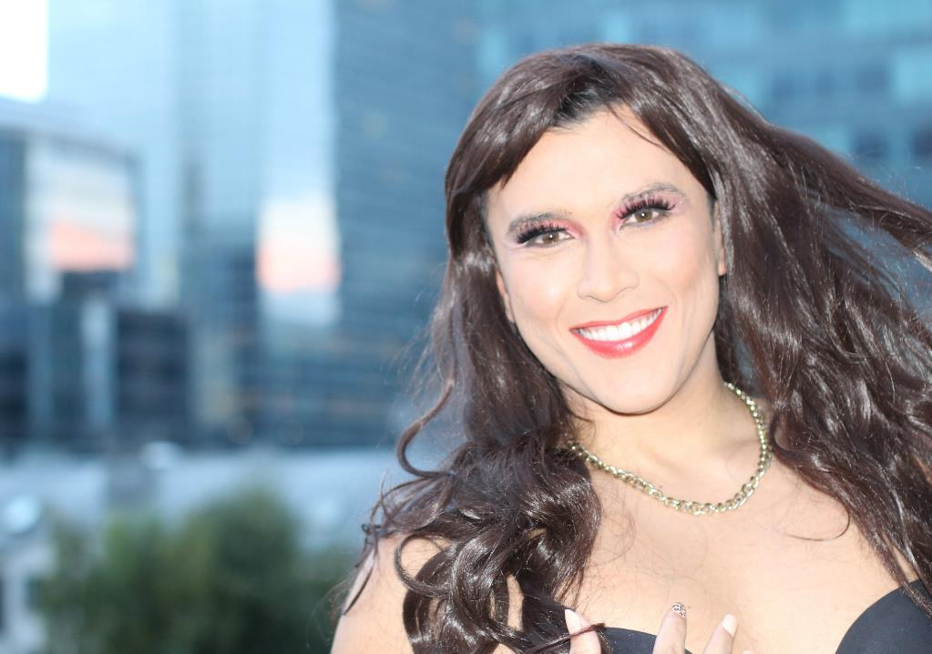
Trans-women should be allowed to compete in women's elite sport.
Agree or disagree?

Slide 35
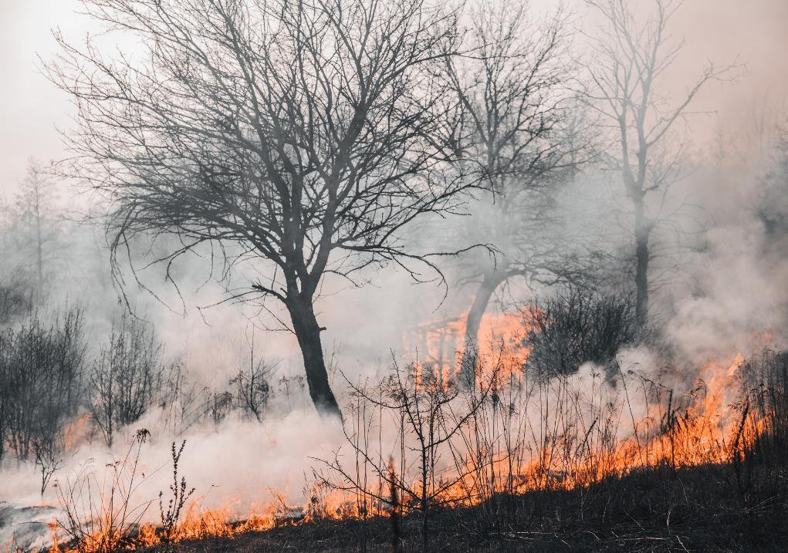
Climate change is at a crisis point so any extreme activism is justified.
Agree or disagree?

Slide 36

It is impossible for social media companies to remove all harmful content.
Agree or disagree?

Slide 37

Unemployment benefit should not be paid where there is an available job (irrelevant of personal skills).
Agree or disagree?

Slide 38

Some people are poor because they waste money and prioritise things that aren't essential e.g., mobile phone contracts, Netflix, take-away food, cigarettes.
Agree or disagree?

Slide 39

Social media should not be available for under-16s
Agree or disagree?

Slide 40

Freedom of speech should not be limited.
Agree or disagree?

Slide 41


There should be national and global controls on the development of artificial intelligence.
Agree or disagree?

Slide 42
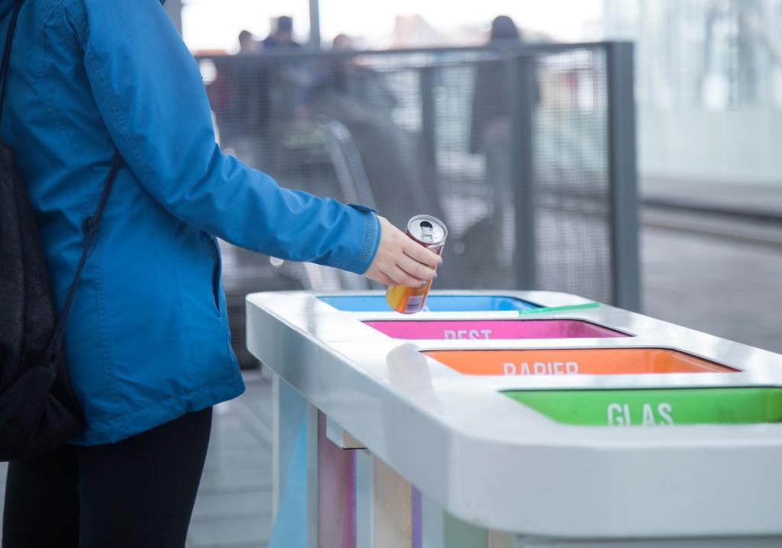
Personal responsibility for the environment is irrelevant when large countries are not taking any action.
Agree or disagree?

Slide 43
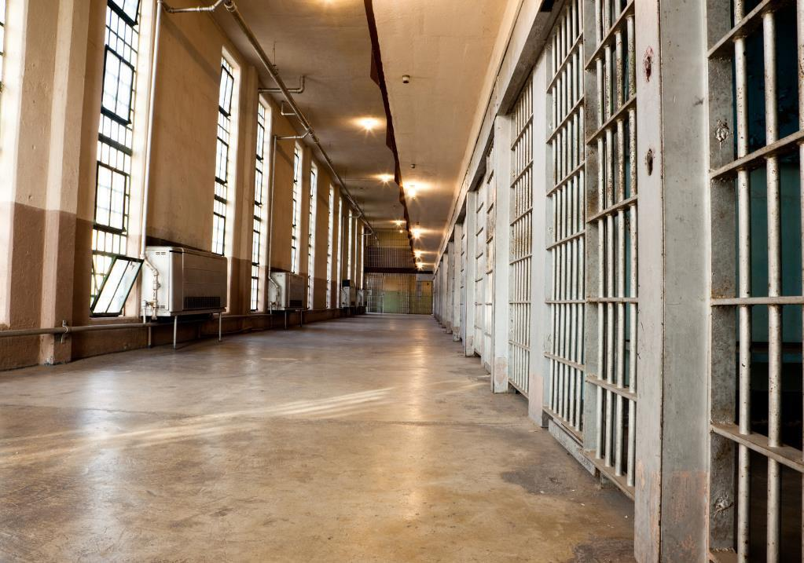
People who steal to fund their drug habit should be put in prison.
Agree or disagree?

Slide 44

Individuals with disabilities should receive more help to get jobs and develop their career.
Agree or disagree?

Slide 45
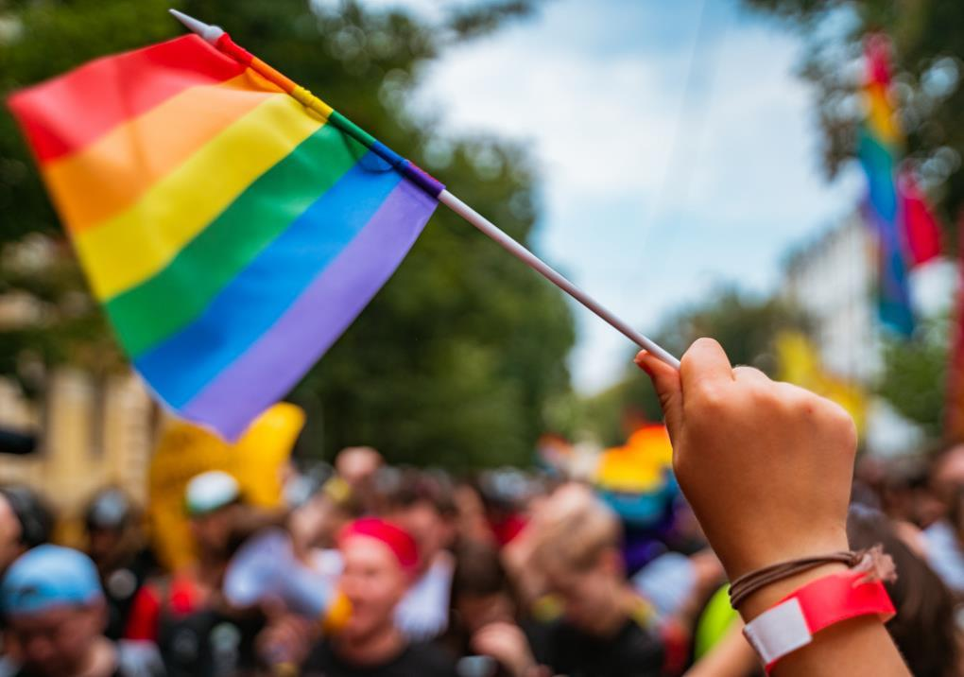
Religious groups who feel that being LGBTQ+ is sinful should be allowed to express this.
Agree or disagree?

Slide 46
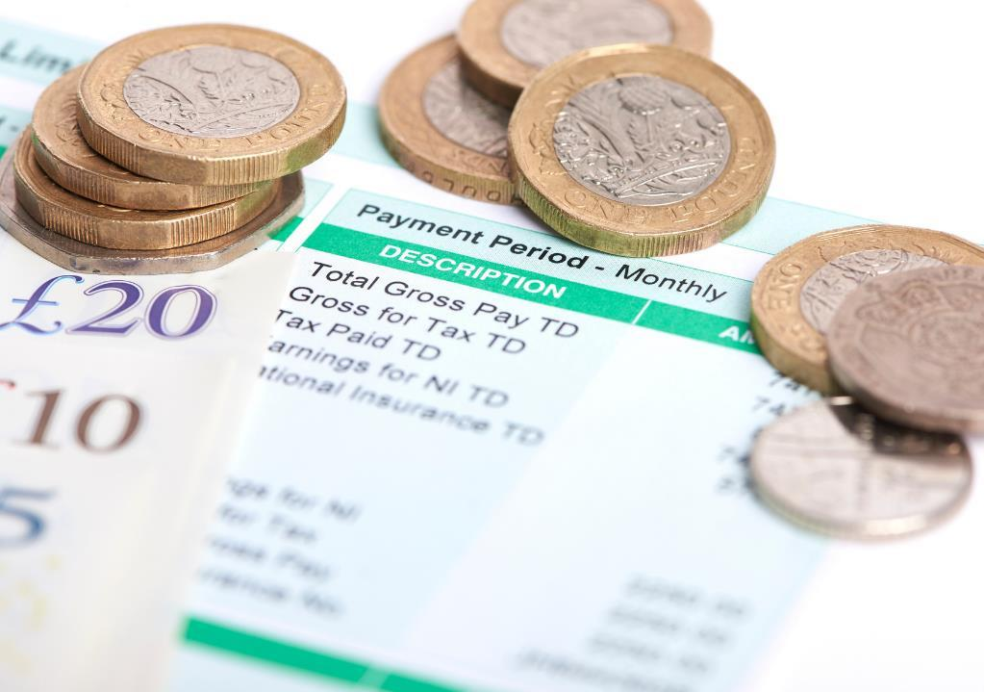
Wages should be paid on merit not gender and this would reduce (eliminate) the gender pay gap.
Agree or disagree?

Slide 47

It's our personal responsibility about what we share and respond to online.
Agree or disagree?

Slide 48
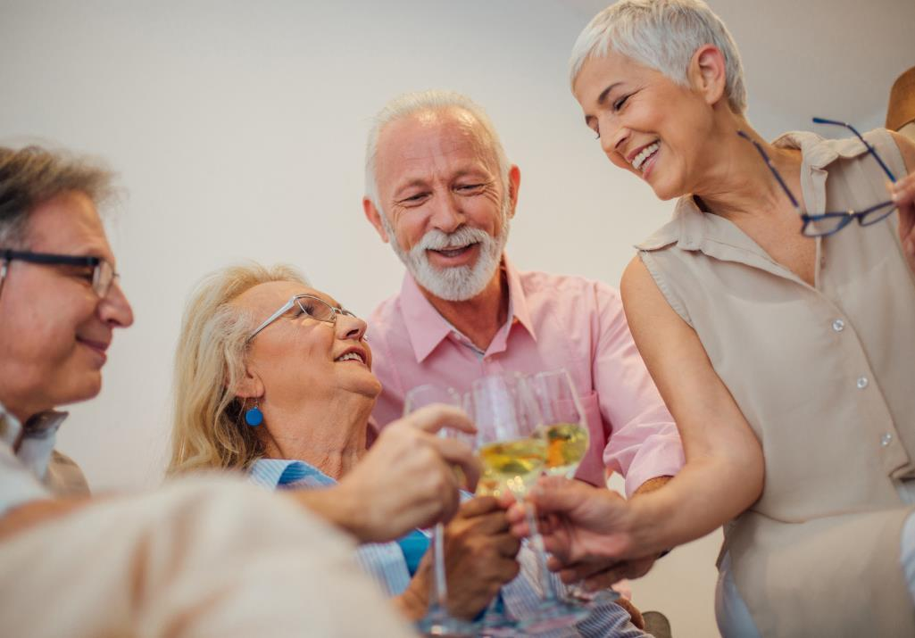
Most older white people are racist.
Agree or disagree?

Slide 49

Challenge Task
Choose a current issue that is important to you but can potentially cause conflict with others.
Plan a speech/presentation to encourage people to come on board and support your point of view but without being confrontational.
Notes:
Challenge activity:
What's important to you?
Choose a current issue that is important to you but can potentially cause conflict with others. Plan a speech/presentation to encourage people to come on board and support your point of view but without being confrontational.

Slide 50
It's a wrap!
There are always going to be topics that elicit passionate views within the community, but inevitably some of these might turn into points of conflict.
Society is grappling with the rights of the individual, balanced with freedom of expression. This is particularly relevant when it comes to social media where we are all 'distanced' from the people we're communicating with and communicating in 'sound-bites' on some platforms. This can sometimes make it challenging to express ourselves clearly and respectfully.
There is also the issue of microaggression to contend with, which can be very subtle but significantly impact the lives of those experiencing it on a regular basis.
More cohesive community may help resolve some of these issues. There may also need to be changes in legislation to clarify what is acceptable and unacceptable in society.

Slide 51
Help and advice
If you ever feel that your rights have been breached by someone else, Citizen's Advice is a helpful place to get further information:
https://www.citizensadvice.org.uk/

